Slide 1
Basics of Preventive Maintenance and Troubleshooting

Slide 2
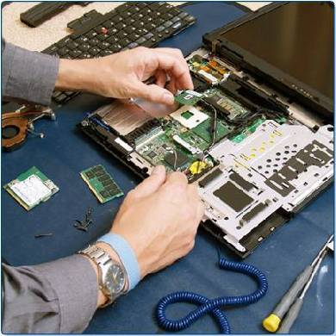
Chapter 4 Objectives
4.1 Explain the purpose of preventive maintenance
4.2 Identify the steps of the troubleshooting process

Slide 3

Chapter 4 Worksheets, Labs, and Activities
Activity: Troubleshooting Process
    (what is the sequence of steps?)

Slide 4
The Purpose of Preventive Maintenance
Reduce the likelihood of hardware or software problems by systematically and periodically checking hardware and software to ensure proper operation.
Reduce computer down time and repair costs.

Slide 5
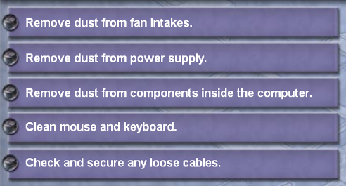
Hardware Maintenance
Make sure that the hardware is operating properly.
Check the condition of parts.
Repair or replace worn parts.
Keep components clean.
Create a hardware maintenance program.

Slide 6
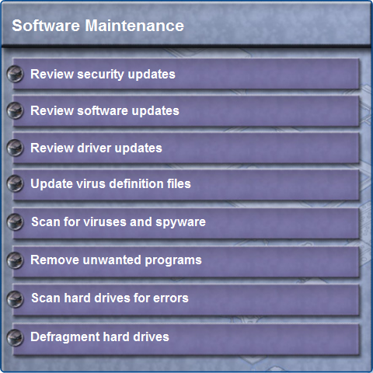
Software Maintenance
Review updates
Follow policies of your organization
Create a schedule

Slide 7
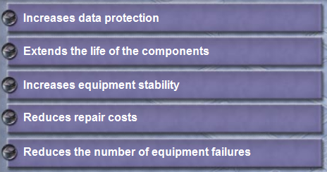
Preventive Maintenance Benefits
Reduce computer down time.
Reduce repair costs.
Reduce loss of worker productivity.

Slide 8
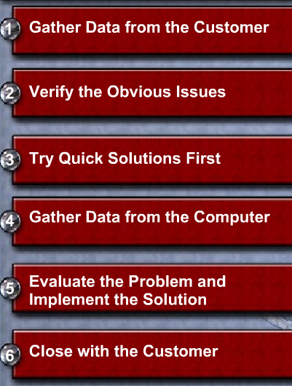
The Troubleshooting Process
Follow an organized and logical procedure.
Eliminate variables one at a time.
Troubleshooting is a skill that is refined over time.
The first and last steps involve effectively communicating with the customer.

Slide 9

Data Protection
Check with customer
Date of the last backup
Contents of the backup
Data integrity of the
backup
Availability of media for
data restore
If no backup can be created, ask customer to sign a release form
Notes:
Slide 10 – Data Protection
4.2.1 Explain the purpose of data protection
Before troubleshooting problems, always follow the necessary precautions to protect data on a computer. Some repairs, such as replacing a hard drive or reinstalling an operating system, may put the data on the computer at risk. Make sure that you do everything possible to prevent data loss while attempting repairs.
Some data is irreplaceable. Before you attempt any type of repair or modification to a computer, make sure that the data has been properly backed up.
CAUTION: Although data protection is not one of the six troubleshooting steps, you must protect data before beginning any work on a customer's computer. If your work results in data loss for the customer, you or your company could be held liable.
If you are unsure that a backup has been done, do not attempt any troubleshooting activities until you check with the customer.
Here is a list of items to verify with the customer about data backups:
Date of the last backup
Contents of the backup
Data integrity of the backup
Availability of all backup media for data restore
If the customer does not have a current backup and you are not able to create one on the computer that has the problem, you should ask the customer to sign a liability release form.
A liability release form should contain at least the following information:
Permission to work on the computer without a current backup available
Release from liability if data is lost or corrupted
Description of the work to be performed
Teaching Strategy: A technician should take precautions before starting the troubleshooting process. For liability reasons, either perform a backup or have access to a backup.
Often, your best troubleshooting resource will be the owner or operator of the equipment which you are working on. Use software and hardware tools to make backups of the customer's data. Bring with you hardware and software that will allow you to change out suspect hardware with known good hardware and boot an operating system that is not booting properly. If you need to make repairs on a system that the customer has not backed-up and if the problem prevents you from making a backup, then obtain written permission from your customer to proceed without the backup. The customer must understand that there is an inherent risk to the data that is stored on the hard drive in many situations.

Slide 10
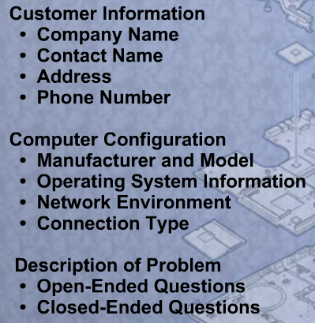
Gather Data from the Customer
Communicate respectfully with the customer
Start with open-ended questions
  “What types of problems are you having with your computer or network?”
Then, ask closed-ended (yes/no) questions
  “Have you changed your password recently?”

Slide 11
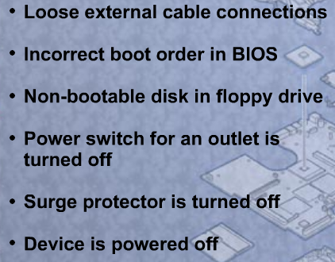
Verify Obvious Issues
Problem may be simpler than the customer thinks.
Checking for obvious issues can save time.
If this step turns up nothing, continue to the next step of the troubleshooting process.
Notes:
Slide 12 - Verify Obvious Issues
4.2.3 Verify the obvious issues
The second step in the troubleshooting process is to check the simple or obvious issues first. Even though the customer may think that there is a major problem, start with the obvious issues before moving to more complex diagnoses.
Here is a list of obvious issues to check:
Loose external cable connections
Incorrect boot order in BIOS
Non-bootable disk in floppy drive
Power switch for an outlet is turned off
Surge protector is turned off
Device is powered off
If the problem is not resolved when you verify the obvious issues, you will need to continue with the troubleshooting process. If you find an obvious issue that fixes the problem, you can go to the last step and close with the customer. These steps are simply a guideline to help you solve problems in an efficient manner.
Teaching Strategy: The customer may say that a device is broken, but the problem may be a connection issue or some other simple issue. Even if the customer is in a panicked state, start with the basics before moving to more difficult troubleshooting techniques. This could save you and the customer time.
Based upon the problem that the user is experiencing, make sure that simple, basic problems that can be easily seen and corrected are covered. Very often, obvious issues can be overlooked by the customer.
The list of suggested obvious issues is not an exhaustive list. The more experience you gain with troubleshooting, the larger this list will become and the easier these problems will be to identify.

Slide 12
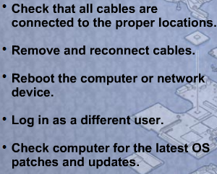
Try Quick Solutions
May provide additional
information, even if they
do not solve the problem.
Document each solution
you try.
May need to gather more
information from the customer.
If you find the problem at this stage, document it and proceed to the end of the troubleshooting process.

Slide 13
Gather Data from the Computer
When system, user, or software errors occur on a computer, the Event Viewer is updated with information about the errors:
  What problem occurred
  The date and time of the
  problem
  The severity of the problem
  The source of the problem
  Event ID number
  Which user was logged in when the problem occurred
Although this utility lists details about the error, you may still need to research the solution.

Slide 14
Gather Data from the Computer
Device Manager
Notes:
Slide 15 – Gather Data from the Computer
The Device Manager displays all of the devices that are configured on a computer. Any device that the operating system determines to be acting incorrectly will be flagged with an error icon. This type of error is denoted as a yellow circle with an exclamation point ("!"). If a device is disabled, it will be flagged with a red circle and an "X".

Slide 15
Gather Data from the Computer
When troubleshooting, power on the computer and listen to the beep code sequence. Document the beep code sequence and research the code to determine the specific hardware failure.
If the computer boots and stops after the POST, investigate the BIOS settings to determine where to find the problem. Refer to the motherboard manual to make sure that the BIOS settings are accurate.
Conduct research to find software to use to diagnose and solve problems. Often, manufacturers of system hardware provide diagnostic tools of their own.
What third-party tools are you aware of to use in computer troubleshooting?

Slide 16
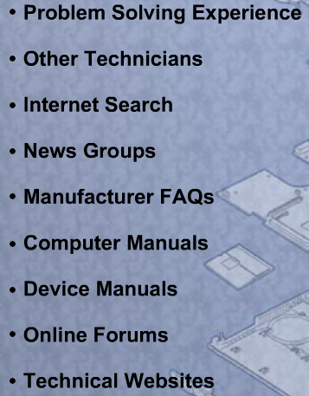
Evaluate the Problem, Implement the Solution
Research possible solutions:
Prioritize solutions to try.
Try easiest solutions first.
After an unsuccessful try, undo any changes you have made.
  Unnecessary changes could complicate finding the solution.

Slide 17
Close with the Customer
Discuss the solution with the customer
Have the customer confirm that the problem has been solved
Document the process
  Problem description
  Solution
  Components used
  Amount of time spent in solving the problem

Slide 18
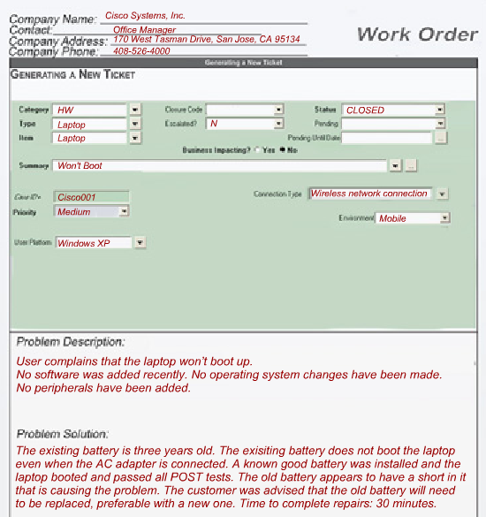

Completed Work Order
The gratifying results of a day’s work
Notes:
Slide 19 – Completed Work Order
4.2.7 Close with the customer
Document the repair in the work order and in your journal. The documentation should include the following information:
The description of the problem
The steps to resolve the problem
The components used in the repair
The amount of time spent to resolve the problem
Finalizing a work order is the goal of any technician solving a problem.
Student Activity: Troubleshooting Process (The student course content includes a sequencing activity in 4.2.7. To complete this activity, students will put into sequence the steps of the troubleshooting process.)

Slide 19

Chapter 4 Summary
Regular preventive maintenance reduces hardware and software problems.
Before beginning any
repair, back up the data
on a computer.
The troubleshooting
process is a guideline
to help you solve
computer problems
in an efficient manner.
Document everything that you try, even if it fails. The documentation that you create will become a useful resource for you and other technicians.
Notes:
Slide 20 - Chapter 4 Summary
This chapter discussed the concepts of preventive maintenance and the troubleshooting process.
Regular preventive maintenance reduces hardware and software problems.
Before beginning any repair, back up the data on a computer.
The troubleshooting process is a guideline to help you solve computer problems in an efficient manner.
Document everything that you try, even if it fails. The documentation that you create will become a useful resource for you and other technicians.

Slide 20

Q and A
Notes:
Slide 24 – Q and A

